Slide 1

Waste Expo
State of C+I Waste
October 2023
Mike Ritchie

Slide 2
Waste generation growth
4.4x population growth
0.9x economic growth
Notes:
Excluding fly ash
Source: 2007 Year Book Australia, 2007 & Waste Account, Australia 2010-11, 2014 by ABS
http://www.abs.gov.au/AUSSTATS/abs@.nsf/DetailsPage/1301.02007?OpenDocument http://www.abs.gov.au/ausstats/abs@.nsf/mf/4602.0.55.006
Updated with 2018/19 data. Source: National Waste Report 2020 https://www.environment.gov.au/system/files/pages/5a160ae2-d3a9-480e-9344-4eac42ef9001/files/national-waste-report-2020.pdf Note that resource recovery (which includes EfW, LFG capture and recycling was 63% (43.5Mt recycling + 2.136Mt EfW + LFG).
Economy: IMF data, Australia: Gross domestic product, current prices (Purchasing power parity; international dollars), Data last updated: 09/2019 https://www.imf.org/external/pubs/ft/weo/2019/02/weodata/weorept.aspx?pr.x=69&pr.y=16&sy=1980&ey=2024&scsm=1&ssd=1&sort=country&ds=.&br=1&c=193&s=NGDP_RPCH,PPPGDP,PPPPC,PCPIPCH,LUR,GGXWDG_NGDP&grp=0&a=#cs2

Slide 3
More waste, more recycling
Notes:
Updated with 2018/19 data. Source: National Waste Report 2020 https://www.environment.gov.au/system/files/pages/5a160ae2-d3a9-480e-9344-4eac42ef9001/files/national-waste-report-2020.pdf

Slide 4
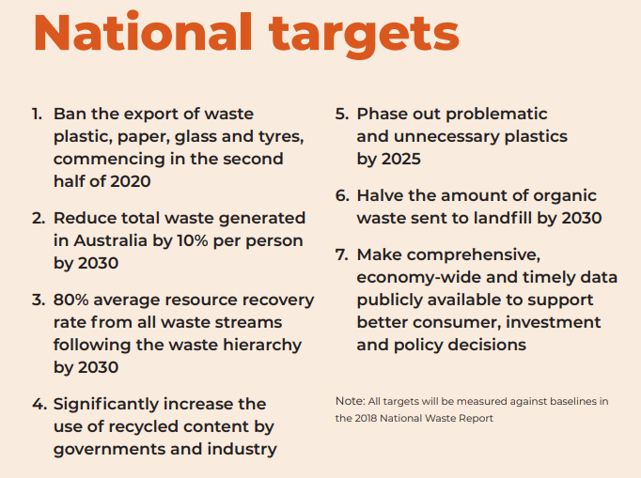
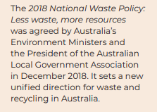

Slide 5
To hit 80% diversion - Target
Notes:
Updated with 2018/19 data. Source: National Waste Report 2020 https://www.environment.gov.au/system/files/pages/5a160ae2-d3a9-480e-9344-4eac42ef9001/files/national-waste-report-2020.pdf

Slide 6
Notes:
Excluding fly ash
Note that 61.5Mt> 43.5+27.2. The balance is energy recovery.
Source: 2007 Year Book Australia, 2007 & Waste Account, Australia 2010-11, 2014 by ABS
http://www.abs.gov.au/AUSSTATS/abs@.nsf/DetailsPage/1301.02007?OpenDocument http://www.abs.gov.au/ausstats/abs@.nsf/mf/4602.0.55.006
Updated with 2018/19 data. Source: National Waste Report 2020 https://www.environment.gov.au/system/files/pages/5a160ae2-d3a9-480e-9344-4eac42ef9001/files/national-waste-report-2020.pdf Note that resource recovery (which includes EfW, LFG capture and recycling was 63% (43.5Mt recycling + 2.136Mt EfW + LFG).

Slide 7
Waste Generation
New National Target - 80% by 2030
1996
2022
Generation
22.7 Mt
Generation
64 Mt
60%
7%
Recycling 1.5 Mt
Recycling 40 Mt
Recovery 1.5 Mt
Another
18 MT/yr recycled by 2030
21.2 Mt Landfill
~23 Mt Landfill*
Source: ABS Year Book 2014; National Waste Report 2018
* The balance of landfilled/recycled is waste recovered as energy, including via LFG.
Notes:
Excluding fly ash
Note that 61.5Mt> 43.5+27.2. The balance is energy recovery.
Source: 2007 Year Book Australia, 2007 & Waste Account, Australia 2010-11, 2014 by ABS
http://www.abs.gov.au/AUSSTATS/abs@.nsf/DetailsPage/1301.02007?OpenDocument http://www.abs.gov.au/ausstats/abs@.nsf/mf/4602.0.55.006
Updated with 2018/19 data. Source: National Waste Report 2020 https://www.environment.gov.au/system/files/pages/5a160ae2-d3a9-480e-9344-4eac42ef9001/files/national-waste-report-2020.pdf Note that resource recovery (which includes EfW, LFG capture and recycling was 63% (43.5Mt recycling + 2.136Mt EfW + LFG).

Slide 8
By 2030
1996
2030
Generation
22.7 Mt
Generation
70Mt
80%
7%
Recycling 1.5 Mt
Recovery 1.5 Mt
Recycling 56 Mt
18 MT/yr growth in 10 years
21.2 Mt Landfill
14 Mt Landfill*
Source: ABS Year Book 2014; National Waste Report 2018
* The balance of landfilled/recycled is waste recovered as energy, including via LFG.
Notes:
Excluding fly ash
Note that 54.5Mt> 31.7+21.7. The balance is energy recovery.
Source: 2007 Year Book Australia, 2007 & Waste Account, Australia 2010-11, 2014 by ABS
http://www.abs.gov.au/AUSSTATS/abs@.nsf/DetailsPage/1301.02007?OpenDocument http://www.abs.gov.au/ausstats/abs@.nsf/mf/4602.0.55.006
Updated with 2016/17 data. Source: National Waste Report 2018 https://www.environment.gov.au/system/files/resources/7381c1de-31d0-429b-912c-91a6dbc83af7/files/national-waste-report-2018.pdf Note that resource recovery (which includes EfW, LFG capture and recycling was 62% (31.7Mt recycling + 1.973Mt EfW + LFG).

Slide 9
What we landfill and recycle
64 Mt
core waste generated
8.7Mt Mixed C+I
7.5 Organics
6.5 Mixed C+D
2.2 Plastics
0.7 Textiles
0.7 Metals
0.3 Tyres
0.2 Paint
0.0008
Coffee cups
Oil: 0.69 Mt
Masonry: 16.0 Mt
Plastics: 0.34 (15%)
Organics: 7.8 Mt
Tyres: 0.17 (56%)
Metals: 4.8 Mt
Paint : 0.03 (15%)
Mattresses: 0.02
23 Mt
Tonnages based on:
- Core waste data from National Waste Report 2022.
- *BioPak 2018
Landfill
Notes:
critically review myths (plastic bag) and decide on priority streams based on bang for $ (s 46-47)

Slide 10
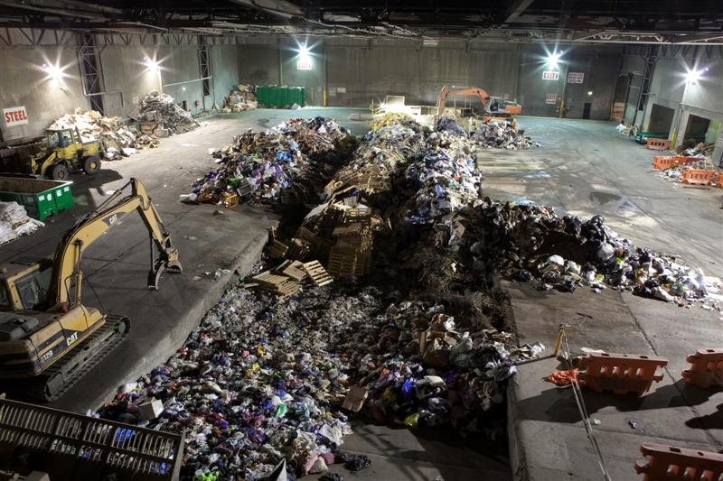
Davis Rd

Slide 11
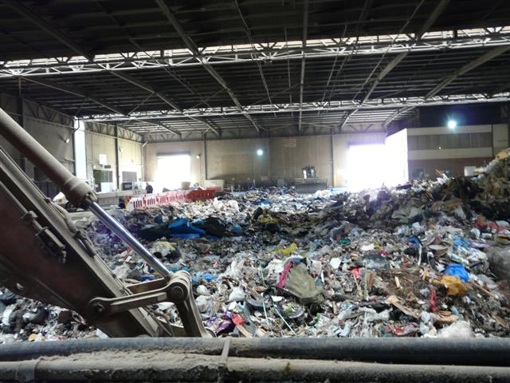
Davis Rd

Slide 12
Victoria – 2.1 MT new C+I recycling to hit target

Slide 13
QLD 1.8 MT

Slide 14
NSW 1.5 MT

Slide 15
8.5 MT being landfilled
6.25 MT – Vic, QLD, NSW, WA alone to hit targets
WA 0.7 MT

Slide 16
Economic principles of Waste
Waste is like a river - it flows downhill to the cheapest price
Most recycling is uneconomic – subsidised by you
Organics are the biggest stream but uneconomic to recycle compared to under-priced landfill
To hit 80% government targets
  Better recycling
  Properly priced landfills
  FOGO/ COFO collections
  EfW

Slide 17
How do we lift C+I recycling?
1. Landfill levies drive recycling
2. Source separation
3. Sorting infrastructure
4. EPR schemes
5. Weight based billing
6. Circular economy interventions
7. Efw

Slide 18
  1. Landfill Levies
Tas
Notes:
Emphasising issues with underpriced landfills

Slide 19
Levies – shift the inflection point
$1000/t
Plastic bags
High $ Value
Large Tonnage
Butts
Cost per tonne ($)
CD’s
E waste
Returned food
Hard Plastics
Mattress
Textiles
Rising
levies
Wood
Glass
batteries
Organics- Food waste, Manure
Fluoro tubes
$0 /t
Concrete
cardboard
Diversion rate from landfill
Metals

Slide 20
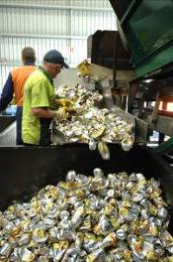
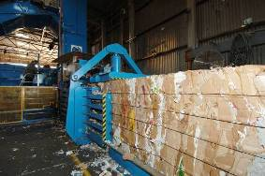
2. Source separation
Get the price signals right
Educate
Drive separation for:
  Food
  Cardboard
  Plastics
  Polystyrene
  Green waste
  Steel
  Aluminum
NSW Govt Mandate (above a size threshold)
– must have a COFO collection by 2025
  Supermarkets
  Retail
  Institutions
  Food manufactures

Slide 21
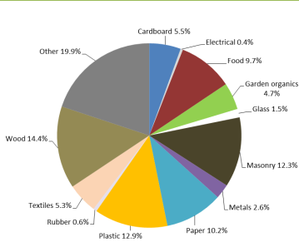
3. Sorting infrastructure – Dirty MRFs
Only 2 in Sydney - 70kt out of 8.5 MT being landfilled;
  some C+D facilities blending C+I waste in
The reason is economics
  Cheaper to landfill mixed C+I than separate and recycle
  Contaminated by food waste and liquids
  Recoverable materials ~ 40% of stream (cf C+D at 80%)
Gate fee $300 /t
Sorting $150 /t
38% Sales:
Basket of goods ~ $123
62% Landfill: -$320

Slide 22
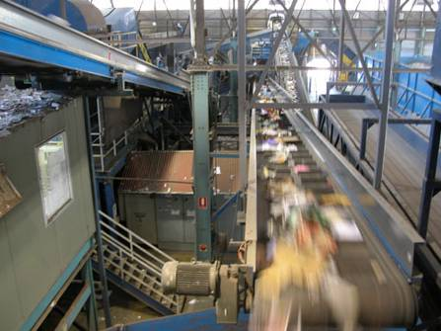
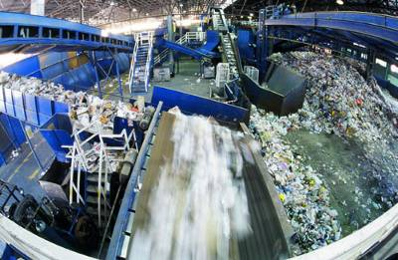
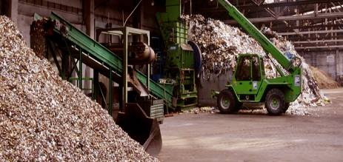
C+I Dirty MRF

Slide 23
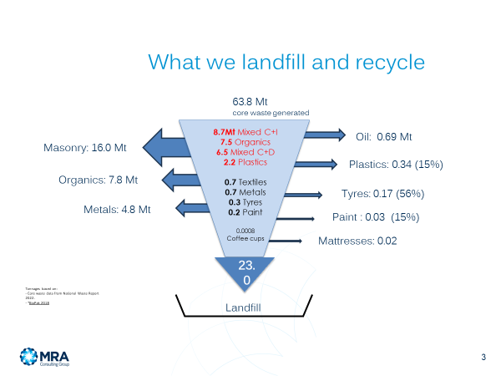
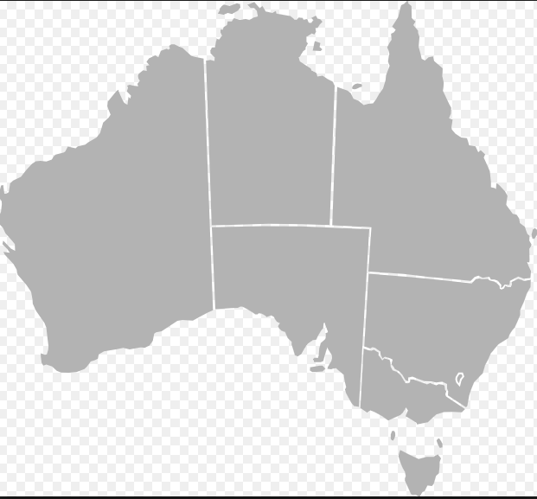
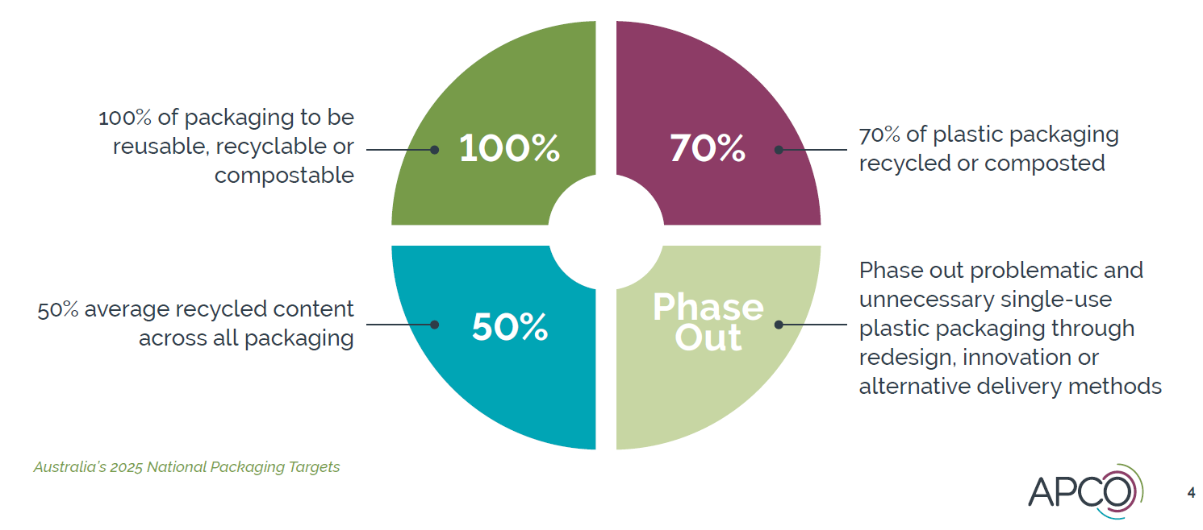
4 EPR, CDS, Plastic packaging
Current EPR is weak
  CDS, Tyres and Oil making a difference
  Rest are capturing a small %
Recycling and Waste Reduction Act 2020 (Federal)
  Needs to be used
  Made mandatory
  Ban non-recyclable products
CDS
EPR proposed List
  Textiles
  Soft plastic
  Ag plastic
  PVC
  Furniture
  Refrigerators
  Air conditioners
  Bedding
  Plant pots
  Batteries
  Dairy silage
  Nappies
  Sports equipment and shoes
  Cosmetics
  Cups
  Coffee pods
  Bikes
  Car seats
✓
✓
✓
✓
✓
✓
✓
2023
✓
2023
18%

Slide 24
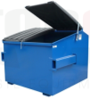


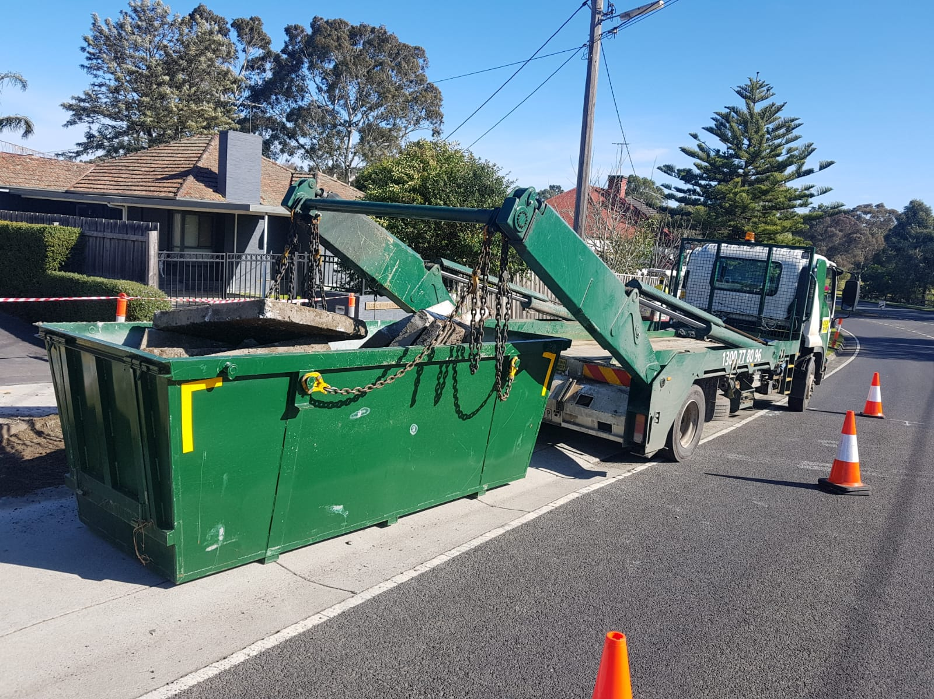
5. Weight Based Billing
Volume based charging – weak price signal
WBB – pay for the weight in the bin:
  more aware of the true cost
  adjust behaviour with immediate savings
45% reduction in waste to landfill in UK
Most C+I is volume based billing
$/m
C&D is already weight based
Waste contractors -assume a density to determine disposal cost and to calculate the lift rate

Slide 25
6. Circular Economy - Pragmatic steps
Broken at both ends
Economy
Design
Reuse/ Recycling
Must haves:
Design for reuse and recycling rules
Recycling labelling rules
Recycled content rules
Extended Producer Scheme rules
Must haves:
Economics to drive recycling
Collection systems esp. organics
Landfill levies and bans
Govt procurement rules
Planning for infrastructure
Supply chain restructure

Slide 26
  7. Energy from Waste
QLD – 1
ResourceCo Hemmant $50m 150kt
Remondis
WA – 2
Kwinana – Veolia 400kt
East Rockingham - Veolia 400kt
NSW – 3 ?
Reg Growth- Parkes - 400kt
Veolia- Woodlawn - 400kt
Richmond Valley - ?
TNG Sydney – Eastern Ck
Suez Sydney - Botany
Cleanaway Sydney – Eastern Ck
Re.Group Lithgow
CWY Greenspot Wallerawang- Lithgow
Jerrara Goulburn
VIC – 4
Opal - 350kt
Sims – 150kt
GSWT - 150kt
REA – 150kt
1 MT CAP
Notes:
Source: EPA data provided for WLRM 2 Justification Project

Slide 27
Conclusions
We have no chance of hitting the C+I Targets without government action
Any combination of these actions will accelerate reform:
  Landfill levies
  Source separation
  Sorting infrastructure
  EPR schemes
  Weight based billing
  Circular economy interventions
  Efw

Slide 28


Thank you
MRA Consulting Group
Suite 408 Henry Lawson Building?19 Roseby Street Drummoyne NSW 2047
P 02 8541 6169?
info@mraconsulting.com.au
mraconsulting.com.au
MRA services:
Strategy
Commercial
Circular economy
Planning
Auditing
Carbon and emissions
Engineering
Procurement
Advocacy

