Slide 1



INTELLIGENT WATER NETWORKS
Tomorrow’s water innovations today
WASTE EXPO BIOCHAR PANEL
Jason Cotton
Program Director
OCTOBER 2023

Slide 2


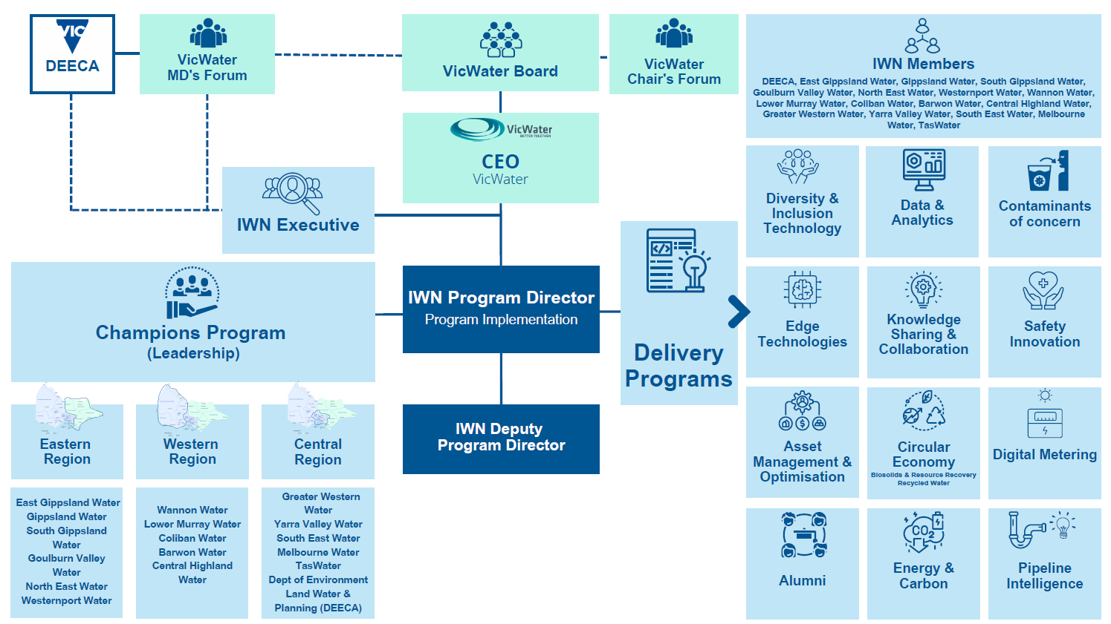




IWN

Slide 3

IWN Driving Roadmap Initiatives
Initiative 2 | Improve stakeholder awareness and education of biochar uses and benefits
Initiative 3 | Integrate and optimise industry and regulatory frameworks
Initiative 4 | Support biochar commercial demonstrations and trials
Initiative 5 | Leverage carbon emission reduction and CO₂ removal opportunities
Initiative 6 | Encourage beneficial use of residual or waste biomass
Initiative 7 | Drive beneficiation and increased value of biochar products and co-products
Initiative 8 | Safeguard responsible use and production of biochar
Initiative 9 | Support government utility and industry procurement practices

Slide 4
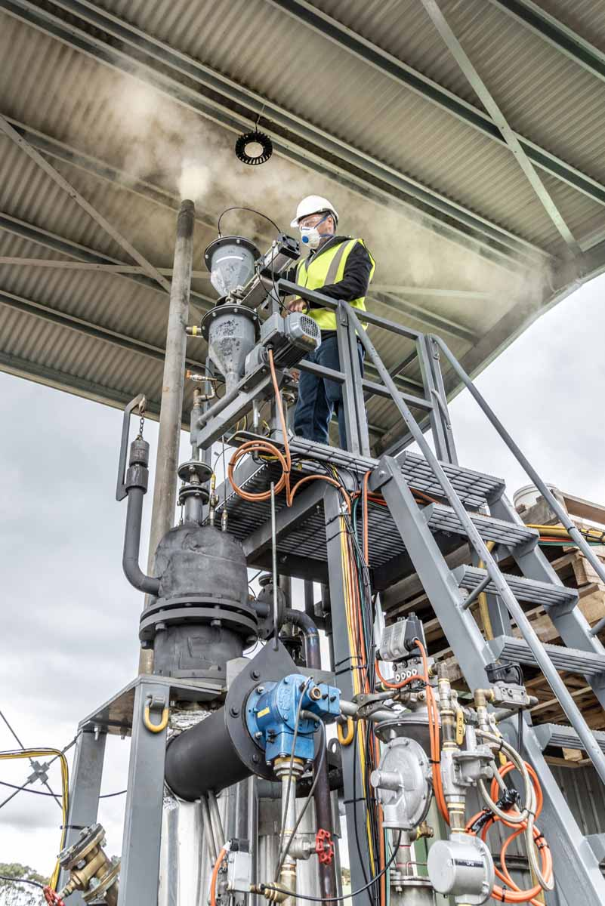
Pyroco Pilot Trial – MK1
Collaboration Partners
South-East Water, IWN, Greater Western Water, RMIT
Pilot Plant Trial at Greater Western Water Melton RWP
April to June 2021
Technical validation
Exceeded expectations

Slide 5
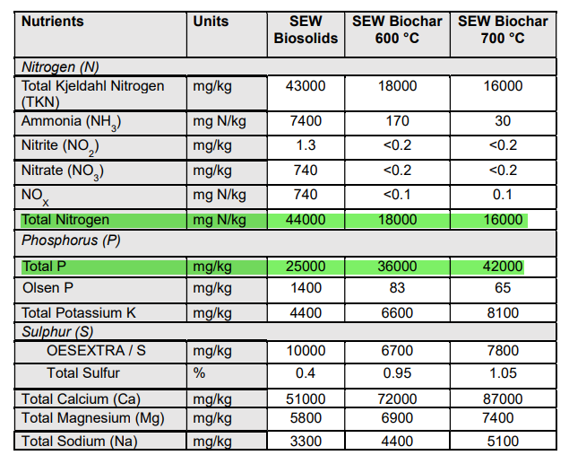
Nutrient Rich Biochar

Slide 6
PFAS Destruction
PFAS | Biosolids | Biochar 600°C | Biochar 700°C
Perfluorohexane Sulfonic Acid (PFHxS) | <2.5 | <2.5 | <2.5
Perfluorooctane Sulfonic Acid (PFOS) | 26 | <2.5 | <2.5
Perfluorooctanoic Acid (PFOA) | 21 | <2.5 | <2.5
Perfluorobutanoic Acid (PFBA) | <10 | <10 | <10
Sum of PFAS | 134 | <2.5 | <2.5

Slide 7
Pharmaceuticals and Personal Care Products Destroyed
PPCPs | Units | Biosolids | Biochar 600⁰C
Gemfibrozil | µg/kg | 2 | 0
Trichlosan* | µg/kg | 360 | 0
Galaxolide** | µg/kg | 2000 | 0
Caffeine | µg/kg | 66 | 0
Carbamazepine*** | µg/kg | 100 | 0
Cetrazine | µg/kg | 5 | 0
*Trichlosan – Antiseptic
**Galaxolide – Synthetic fragrance
***Carbamazepine – Medicine used to treat epilepsy

Slide 8
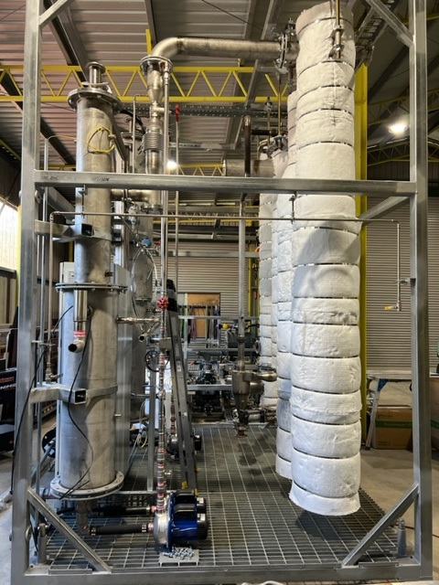
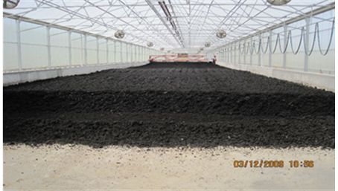
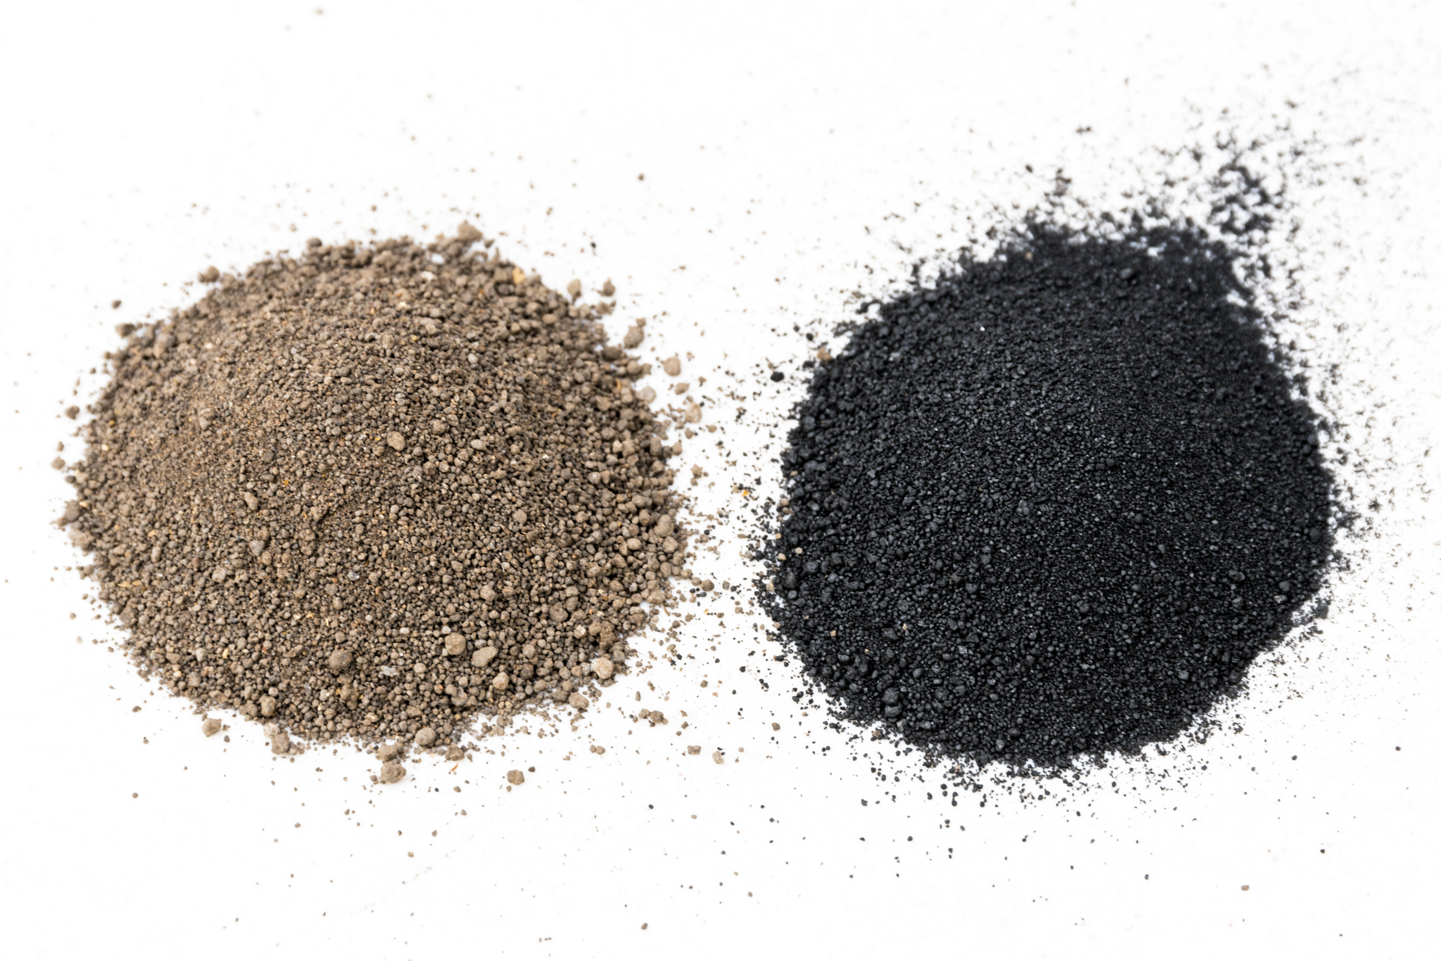


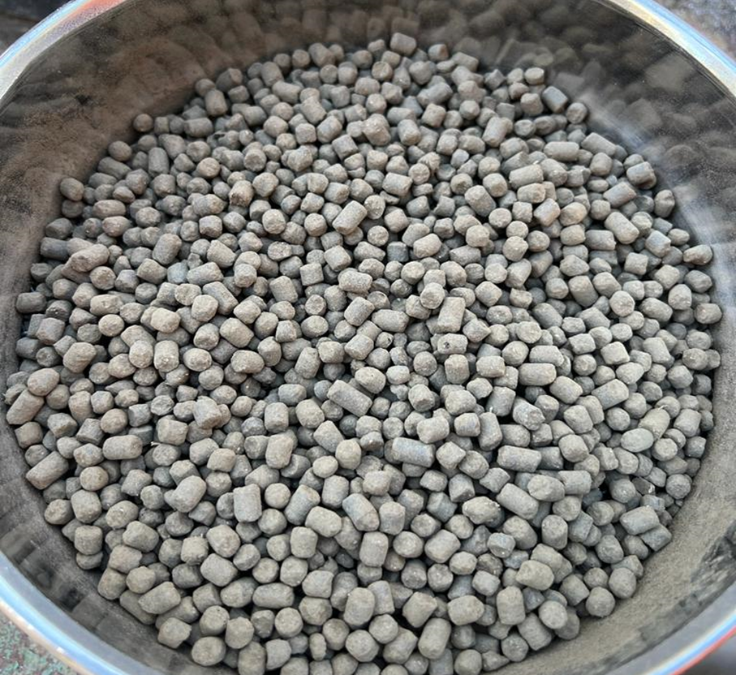
Functionalised Biochar – MK2 Pilot
Co-pyrolysis
Collaboration Partners
South-East Water, DEECA, IWN, Greater Western Water, Barwon Water, East Gippsland Water, Westernport Water, RMIT
Pilot Study commences November 2023
Functionalised Biochar
PYROCO MK2

Slide 9
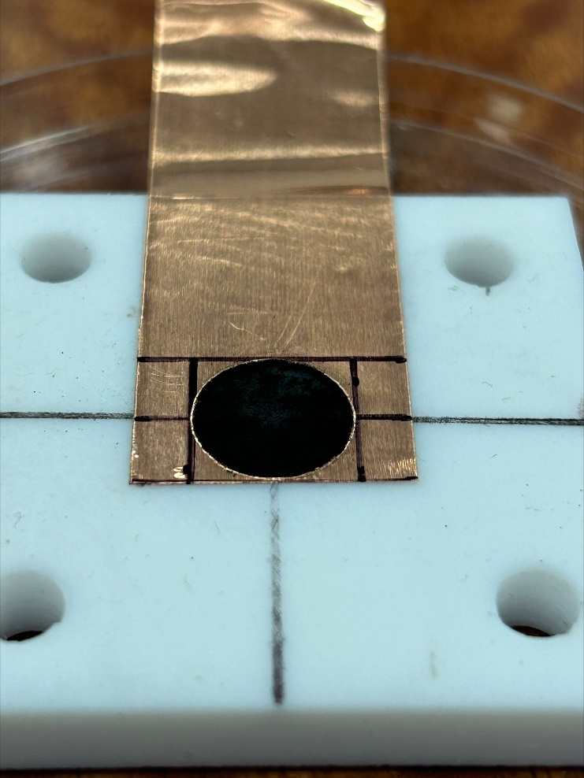
Challenges and Opportunities
Opportunities
Circular economy objectives
Agriculture – carbon, nutrients, trace elements
Carbon sequestration
Advanced carbon materials
  Electrodes for Sodium Ion batteries
  Supercapacitors
Challenges
Biochar from biosolids is classified as a priority reportable waste in Vic
COVID delays
FOGO/biomass and biosolids blending

Slide 10
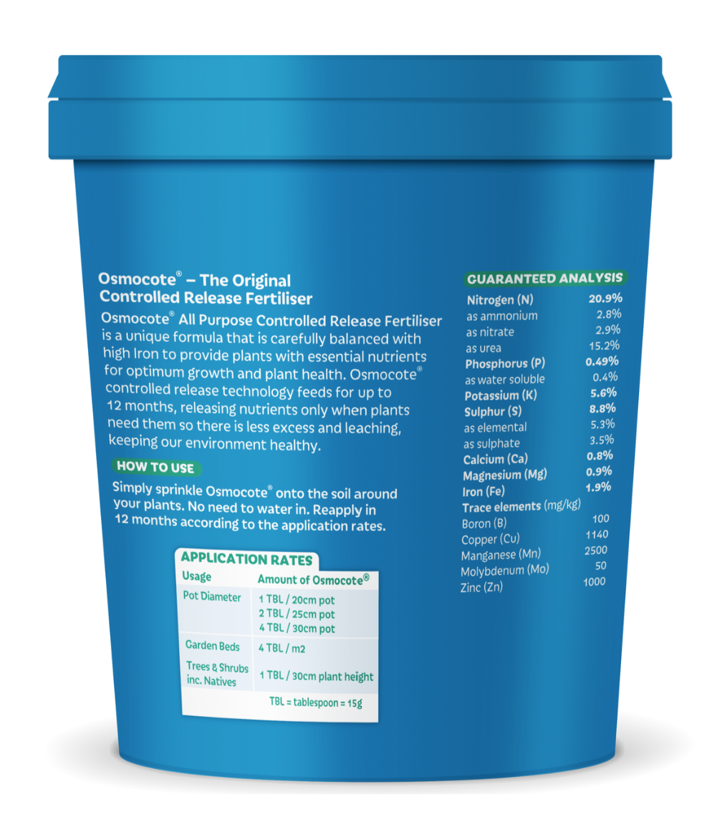
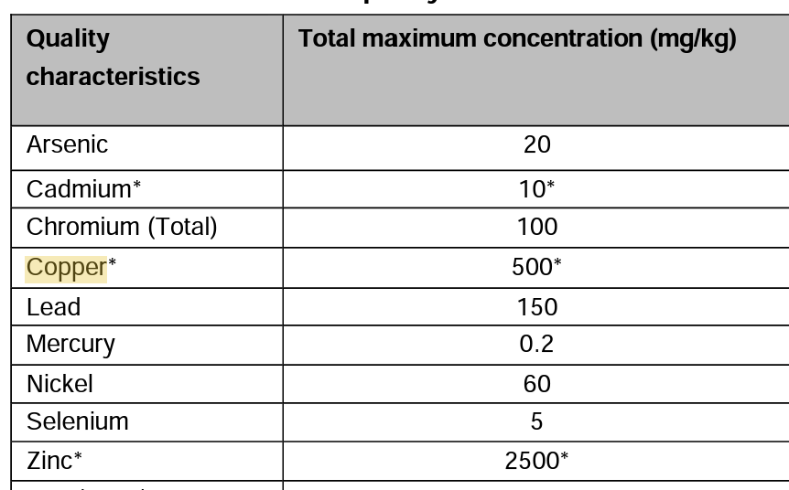

Applications and Risk Based Approach
Queensland DRAFT End of Waste Code Biochar (EOWC010002177)
“So the Poison, be the dose” – move to a Risk-Based Application approach.

